Slide 1

ISDS 552 GP3
TEAM MEMBERS:
DEEPAM KHIRWAR
HARSHITA DIDWANIA
KAVINDU WALIMUNIGE
SANCHIT SINGH
SATHIYA PRIYA JEEVANANDAN

Slide 2
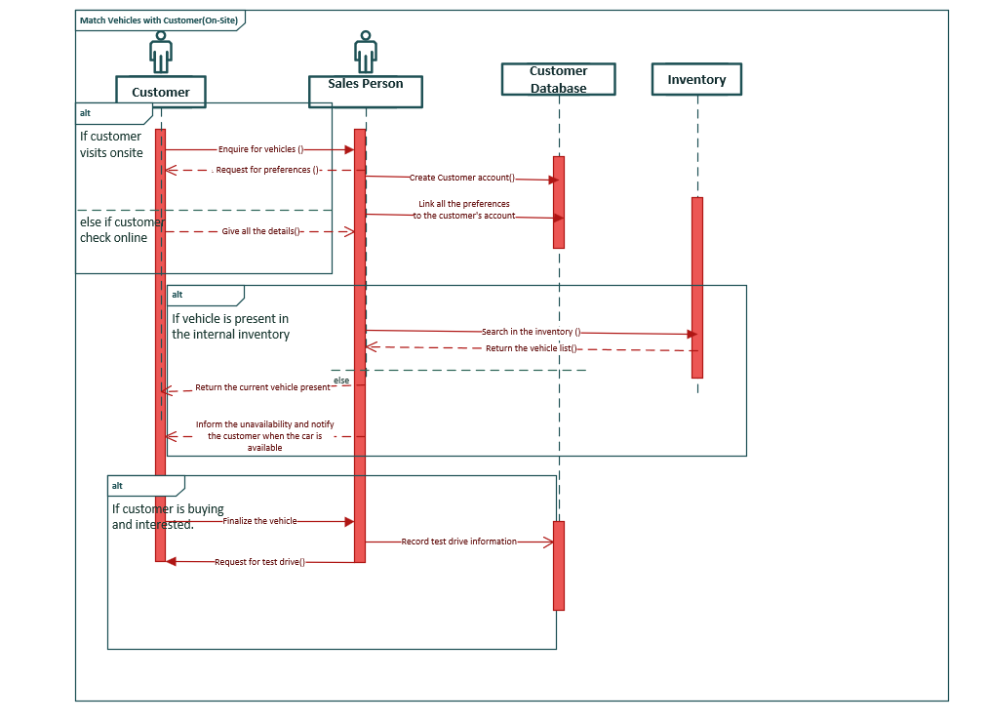
SEQUENCE DIAGRAM- MATCH CUSTOMER WITH VEHICLES

Slide 3
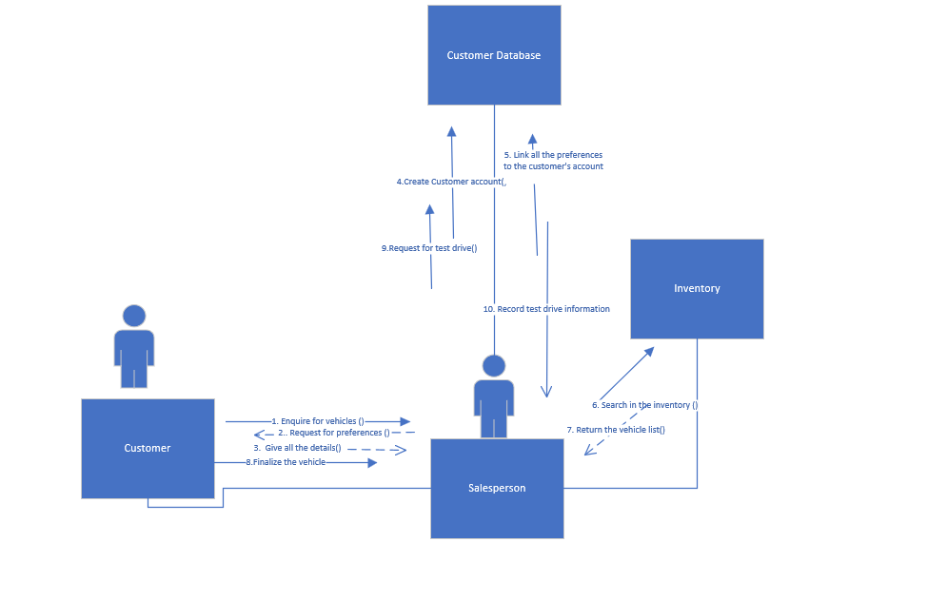
COMMUNICATION DIAGRAM- MATCH CUSTOMER WITH VEHICLES

Slide 4
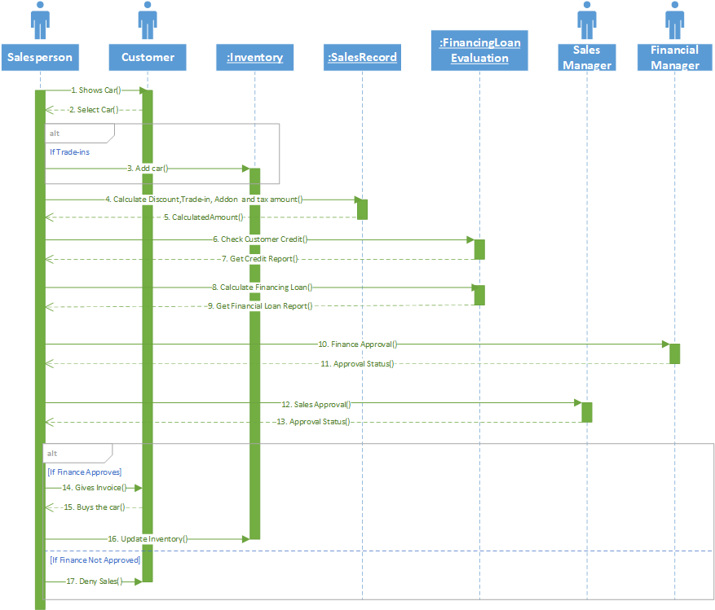
SEQUENCE DIAGRAM- SELL CAR

Slide 5
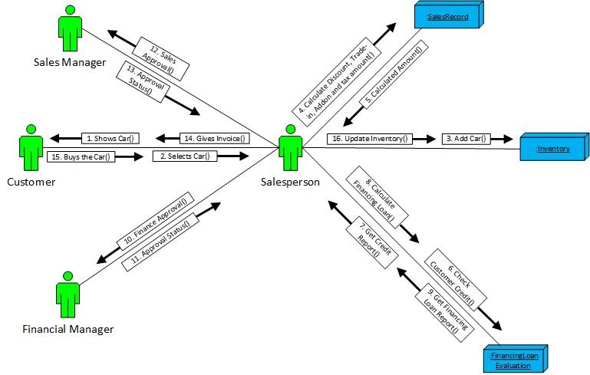
COMMUNICATION DIAGRAM- SELL CAR

Slide 6
SEQUENCE DIAGRAM- IDENTIFY PROMOTIONAL OFFER

Slide 7
COMMUNICATION DIAGRAM – IDENTIFY PROMOTIONAL OFFER

Slide 8
End of presentation
Thank you!

